Slide 1

Lesson 2
Dive into Python world – Operators, statements, method and functions
Tan See Youu

Slide 2
What will cover today?
Operators: +, -, *, /, %, //
Flowchart: Think like a computer
Statements: if, elif, else, for, while
Methods and function

Slide 3
Python Operators
Python language supports the following types of operators:
Arithmetic Operators
Comparison (Relational) Operators
Assignment Operators
Logical Operators
Bitwise Operators
Membership Operators
Identity Operators

Slide 4
Arithmetic Operators
Operator | Description | Example
+ Addition | Adds values on either side of the operator. | a + b = 30
- Subtraction | Subtracts right hand operand from left hand operand. | a – b = -10
* Multiplication | Multiplies values on either side of the operator | a * b = 200
/ Division | Divides left hand operand by right hand operand | b / a = 2
% Modulus | Divides left hand operand by right hand operand and returns remainder | b % a = 0
** Exponent | Performs exponential (power) calculation on operators | a**b =10 to the power 20
// | Floor Division - The division of operands where the result is the quotient in which the digits after the decimal point are removed. But if one of the operands is negative, the result is floored, i.e., rounded away from zero (towards negative infinity) − | 9//2 = 4 and 9.0//2.0 = 4.0, -11//3 = -4, -11.0//3 = -4.0

Slide 5
Comparison Operators
Operator | Description | Example
== | If the values of two operands are equal, then the condition becomes true. | (a == b) is not true.
!= | If values of two operands are not equal, then condition becomes true. | (a != b) is true.
<> | If values of two operands are not equal, then condition becomes true. | (a <> b) is true. This is similar to != operator.
> | If the value of left operand is greater than the value of right operand, then condition becomes true. | (a > b) is not true.
< | If the value of left operand is less than the value of right operand, then condition becomes true. | (a < b) is true.
>= | If the value of left operand is greater than or equal to the value of right operand, then condition becomes true. | (a >= b) is not true.
<= | If the value of left operand is less than or equal to the value of right operand, then condition becomes true. | (a <= b) is true.

Slide 6
Assignment Operators
Operator | Description | Example
= | Assigns values from right side operands to left side operand | c = a + b assigns value of a + b into c
+= Add AND | It adds right operand to the left operand and assign the result to left operand | c += a is equivalent to c = c + a
-= Subtract AND | It subtracts right operand from the left operand and assign the result to left operand | c -= a is equivalent to c = c - a
*= Multiply AND | It multiplies right operand with the left operand and assign the result to left operand | c *= a is equivalent to c = c * a
/= Divide AND | It divides left operand with the right operand and assign the result to left operand | c /= a is equivalent to c = c / ac /= a is equivalent to c = c / a
%= Modulus AND | It takes modulus using two operands and assign the result to left operand | c %= a is equivalent to c = c % a
**= Exponent AND | Performs exponential (power) calculation on operators and assign value to the left operand | c **= a is equivalent to c = c ** a
//= Floor Division | It performs floor division on operators and assign value to the left operand | c //= a is equivalent to c = c // a

Slide 7
Bitwise Operators
a = 0011 1100 (decimal 60)
b = 0000 1101 (decimal 13)
Operator | Description | Example
& (Binary AND) | Operator copies a bit to the result if it exists in both operands | (a & b) (means 0000 1100)
| (Binary OR) | It copies a bit if it exists in either operand. | (a | b) = 61 (means 0011 1101)
^ (Binary XOR) | It copies the bit if it is set in one operand but not both. | (a ^ b) = 49 (means 0011 0001)
~ (Binary Ones Complement) | It is unary and has the effect of 'flipping' bits. | (~a ) = -61 (means 1100 0011 in 2's complement form due to a signed binary number.
<< Binary Left Shift | The left operands value is moved left by the number of bits specified by the right operand. | a << 2 = 240 (means 1111 0000)
>> Binary Right Shift | The left operands value is moved right by the number of bits specified by the right operand. | a >> 2 = 15 (means 0000 1111)

Slide 8
Logical Operators
Operator | Description | Example
and (Logical AND) | If both the operands are true then condition becomes true. | (a and b) is true.
or (Logical OR) | If any of the two operands are non-zero then condition becomes true. | (a or b) is true.
not (Logical NOT) | Used to reverse the logical state of its operand. | Not(a and b) is false.

Slide 9
Membership Operators
Operator | Description | Example
in | Evaluates to true if it finds a variable in the specified sequence and false otherwise. | x in y, here in results in a 1 if x is a member of sequence y.
not in | Evaluates to true if it does not finds a variable in the specified sequence and false otherwise. | x not in y, here not in results in a 1 if x is not a member of sequence y.

Slide 10
Identity Operators
Operator | Description | Example
is | Evaluates to true if the variables on either side of the operator point to the same object and false otherwise. | x is y, here is results in 1 if id(x) equals id(y).
is not | Evaluates to false if the variables on either side of the operator point to the same object and true otherwise. | x is not y, here is not results in 1 if id(x) is not equal to id(y).

Slide 11




Logical thinking tool - Flowchart
ANSI/ISO Shape | Name | Description
 | Flowline (Arrowhead) | Shows the process's order of operation. A line coming from one symbol and pointing at another.Arrowheads are added if the flow is not the standard top-to-bottom, left-to right.
 | Terminal | Indicates the beginning and ending of a program or sub-process. Represented as a stadium, oval or rounded (fillet) rectangle. They usually contain the word "Start" or "End", or another phrase signaling the start or end of a process, such as "submit inquiry" or "receive product".
 | Process | Represents a set of operations that changes value, form, or location of data. Represented as a rectangle.
 | Decision | Shows a conditional operation that determines which one of the two paths the program will take. The operation is commonly a yes/no question or true/false test. Represented as a diamond (rhombus).
 | Input/Output | Indicates the process of inputting and outputting data, as in entering data or displaying results. Represented as a parallelogram.

Slide 12
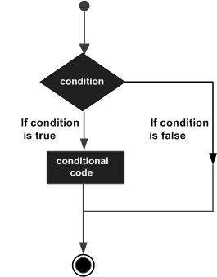
Decision making
Decision making is anticipation of conditions occurring while execution of the program and specifying actions taken according to the conditions.
Decision structures evaluate multiple expressions which produce TRUE or FALSE as outcome. You need to determine which action to take and which statements to execute if outcome is TRUE or FALSE otherwise.
Following is the general form of a typical decision making structure found in most of the programming languages −

Slide 13
Hands-on: Draw your flowchart
Use either word editing software installed in your PC or visit https://www.draw.io/
Use the https://www.draw.io/ feature or Ms Word’s shape draw the following:
Assume you are designing a robo-advisor system to collect user’s information, do the following:
Collect user’s annual income
Collect user’s annual expense
If net income more than 100000, display “You can try high risk investment”
if lower, display “You can try low risk investment”

Slide 14
Decision making statements
Statements | Description
if statement | consists of a boolean expression followed by one or more statements.
if...else statement | if statement can be followed by an optional else statement, which executes when the boolean expression is FALSE.
if...elif...else Statement | The elif is short for else if. It allows us to check for multiple expressions. If the condition for if is False, it checks the condition of the next elif block and so on.
nested if statement | You can use one if or else if statement inside another if or else if statement(s)
Question: Is there switch… case… block in Python?
Let’s see demo

Slide 15
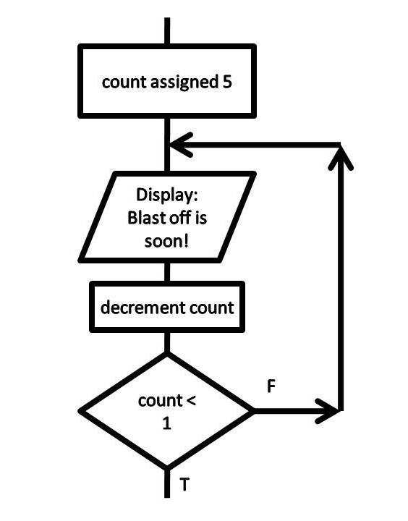
Repeating a process(iteration)
to eliminate the workload in terms of programming and for faster execution without consuming more time.
Iteration is the repetition of a function or process in a computer program. Iterations of functions are common in computer programming, since they allow multiple blocks of data to be processed in sequence. This is typically done using a "while loop" or "for loop".

Slide 16
Loops
To keep a computer doing useful work we need repetition, looping back over the same block of code again and again. Let’s look into loop in Python
Statements | Description
For loop | for loops are traditionally used when you have a block of code which you want to repeat a fixed number of times
While Loop | The while loop tells the computer to do something as long as the condition is met. Its construct consists of a block of code and a condition.
Let’s see demo

Slide 17
Functions and Methods
A function is a block of code which only runs when it is called. You can pass data, known as parameters, into a function. A function can return data as a result. We use ‘def’ to define a function
A method is a type of function which is a member function of a class.
Functions | Python methods
Function is block of code that is also called by its name. (independent) | Method is called by its name, but it is associated to an object (dependent).
Function does not deal with Class and its instance concept. | A method is implicitly passed the object on which it is invoked.
It may or may not return any data. | It may or may not return any data.
The function can have different parameters or may not have any at all. If any data (parameters) are passed, they are passed explicitly. | A method can operate on the data (instance variables) that is contained by the corresponding class.

Slide 18
Useful built-in function
Functions name | Description
input(‘<string>’) | Create an input field to capture user’s input
sum() | Return a summation result of a list of numbers
max() | Return a maximum number from several values
open() | Access a file to either read or write it

Slide 19
Hands-on exercise: Create a function
Create a function which will display the below output:
1
22
333
4444
55555

Slide 20
Useful built-in methods
A class is a code template for creating objects. Objects have member variables and have behaviour associated with them. In python a class is created by the keyword class . An object is created using the constructor of the class. This object will then be called the instance of the class.
Methods are member function of a class
Python methods (example) | Description
math.ceil(0.01) | Return a ceiling value of a floating number
math.floor(0.01) | Return a floor value of a floating number

Slide 21
Hands-on exercise: Loop and built-in function
Write a code to Collect user’s expense type repeatly until user typed ‘q’.
Hints:
You will need to use ‘input()’ function to ask for user input
Use while loop to achieve this
Store users input into set

Slide 22
Basic I/O
Python allows you to read, write and delete files
Use the function open("filename","w+") to create a file. The + tells the python compiler to create a file if it does not exist
To append data to an existing file use the command open(“filename", "a")
Use the read function to read the ENTIRE contents of a file
Use the readlines function to read the content of the file one by one.

Slide 23

Thank You
Q&A

